Slide 1
Financial Accounting
IFRS 5th Edition
Weygandt ● Kimmel
Chapter 11
Non-Current Liabilities
This slide deck contains animations. Please disable animations if they cause issues with your device.
Copyright © John Wiley & Sons, Inc.
Notes:
Current liab: Obligation due within 1 year or 1 operating cycle
Non-current: More than one year or more than 1 operating cycle.

Slide 2
Chapter Outline
Learning Objectives
LO 1 Describe the major characteristics of bonds.
LO 2 Explain how to account for bond transactions.
LO 3 Apply the effective-interest method of amortizing bond discount and bond premium.

Slide 3
Non-Current Liabilities
Obligations that a company expects to pay more than one year (or one operating cycle, whichever is longer) in the future
Examples:
Bonds
Long-term payables

Slide 4
Learning Objective 1 Describe the Major Characteristics of Bonds.
L O 1

Slide 5
Different Methods of Financing
Debt Financing
Borrowing money that you will pay back to lender, with interest
Will affect liabilities; interest expense
Used when have stable cash flow that covers interest payment. No upside for investor.
Equity Financing
Company raises money by selling shares of itself. Exchanging portion of ownership of the company for cash
Affect shareholder’s equity
Used when company do not want pressure of interest payment. Investor has upside.

Slide 6



Debt financing
How does companies borrow money?

Slide 7
Overview of Bonds
Bonds are a form of interest-bearing notes payable issued by companies (公司债), and governments (国债).
The bond market (also debt market/credit market/fixed income market) is a financial market where participants can buy and sell government/corporate bond.
Sold in small denominations (usually €1,000 or multiples of €1,000).
When a company/government issues bonds, it is borrowing money. The person who buys the bonds (the bondholder) is lending money.
The bond buyers are often institutions, i.e., hedge fund, pension fund, endowments, mutual funds, etc, and some individuals.

Slide 8
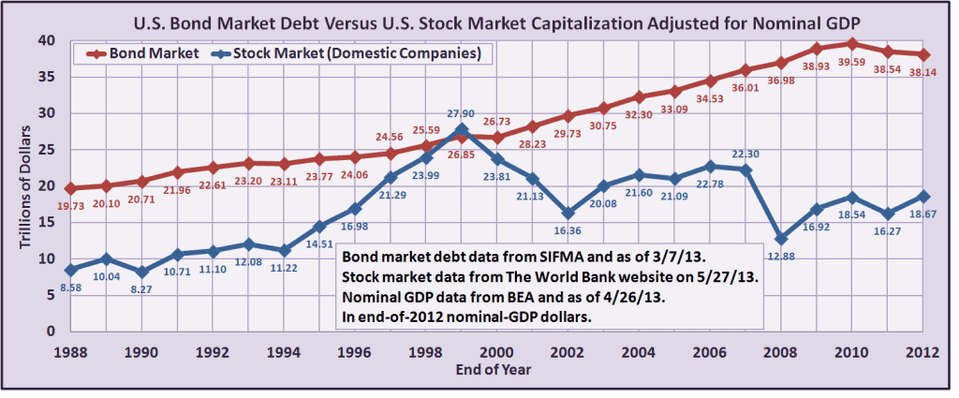
Bond market is larger than the stock market
https://learnbonds.com/news/how-big-is-the-bond-market/

Slide 9
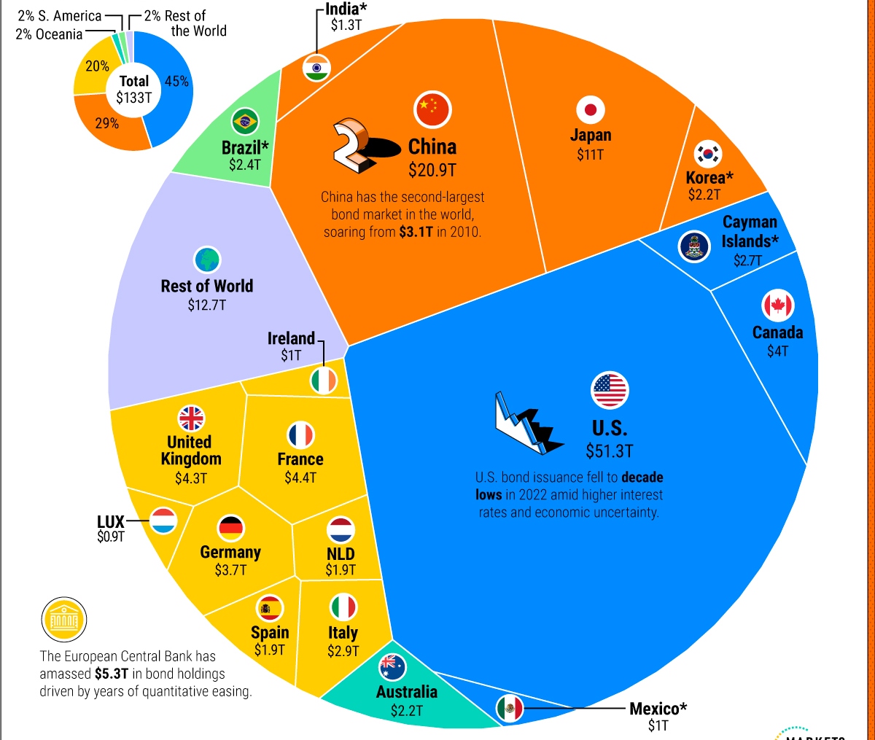
Bond market size by country

Slide 10
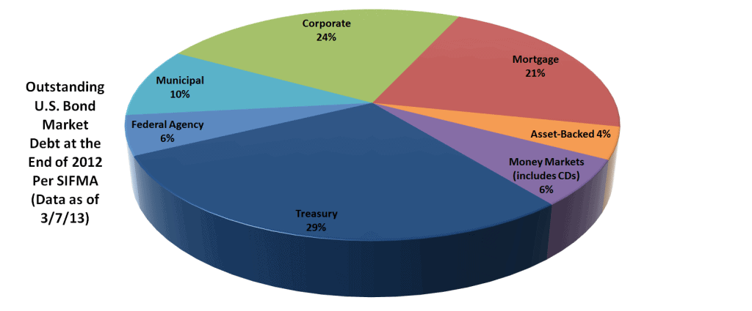
Who issues bond
Caused 2008 financial crisis. If interested, you can watch the movie the big short
政府债/国债

Slide 11
Types of Bonds
Secured and Unsecured Bonds
Secured bonds have specific assets of issuer pledged as collateral for bonds
In case of bankruptcy, bondholder will have claim on the collateral.
Unsecured bonds are issued against general credit of borrower
No collateral involved. Borrower is using their credit (i.e., reputation) to borrow.
L O 1

Slide 12
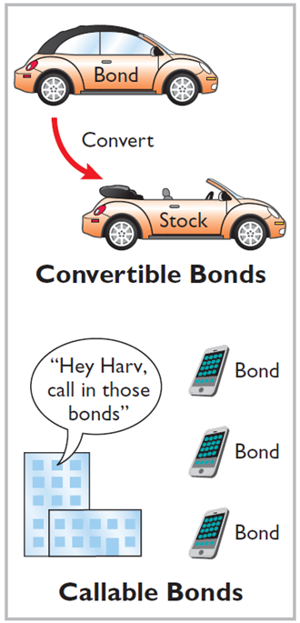
Additional Types of Bonds
Convertible and Callable Bonds
Convertible bonds can be converted into ordinary shares at bondholder’s option
Callable bonds can be redeemed (bought back), by issuing company, at a stated currency amount prior to maturity
L O 1
Notes:
Issuer is borrower.
Bondholder is lender.

Slide 13
Issuing Procedures
Government laws grant companies power to issue bonds
Board of directors and shareholders usually must approve bond issues
Board of directors must stipulate number of bonds to be authorized, total face value, and contractual interest rate
Terms of bond are set forth in a legal document called a bond indenture
Find an investment bank to sell the bond to investors (underwriting)
L O 1

Slide 14
Bond Terminology
Bond certificate
Issued to investor
Provides name of the issuer, face value, contractual interest rate, and maturity date
Face value - principal due at maturity
Amount of money that will be paid back to investor. May not be amount of money borrowed.
Maturity date - date final payment is due
Contractual interest rate – annual rate used to determine cash interest paid, also referred to as the stated rate or coupon rate
L O 1
Notes:
Face value: amount of money that will be paid back to investor (different from notes payable case)… may not be amount of money borrowed.
Everything wil be specificed on bond certificate.

Slide 15
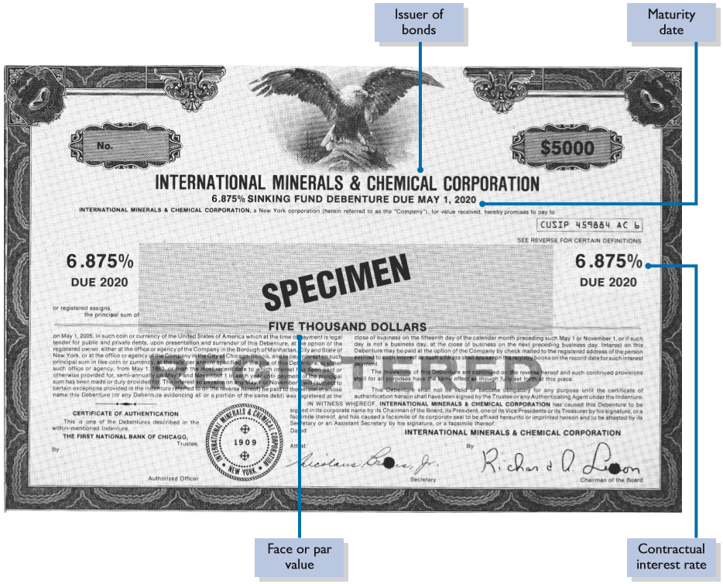
Bond Certificate
Illustration 11.1: Bond certificate
L O 1

Slide 16
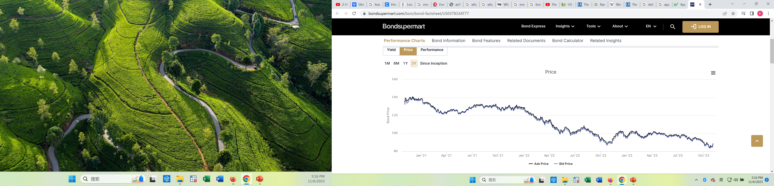
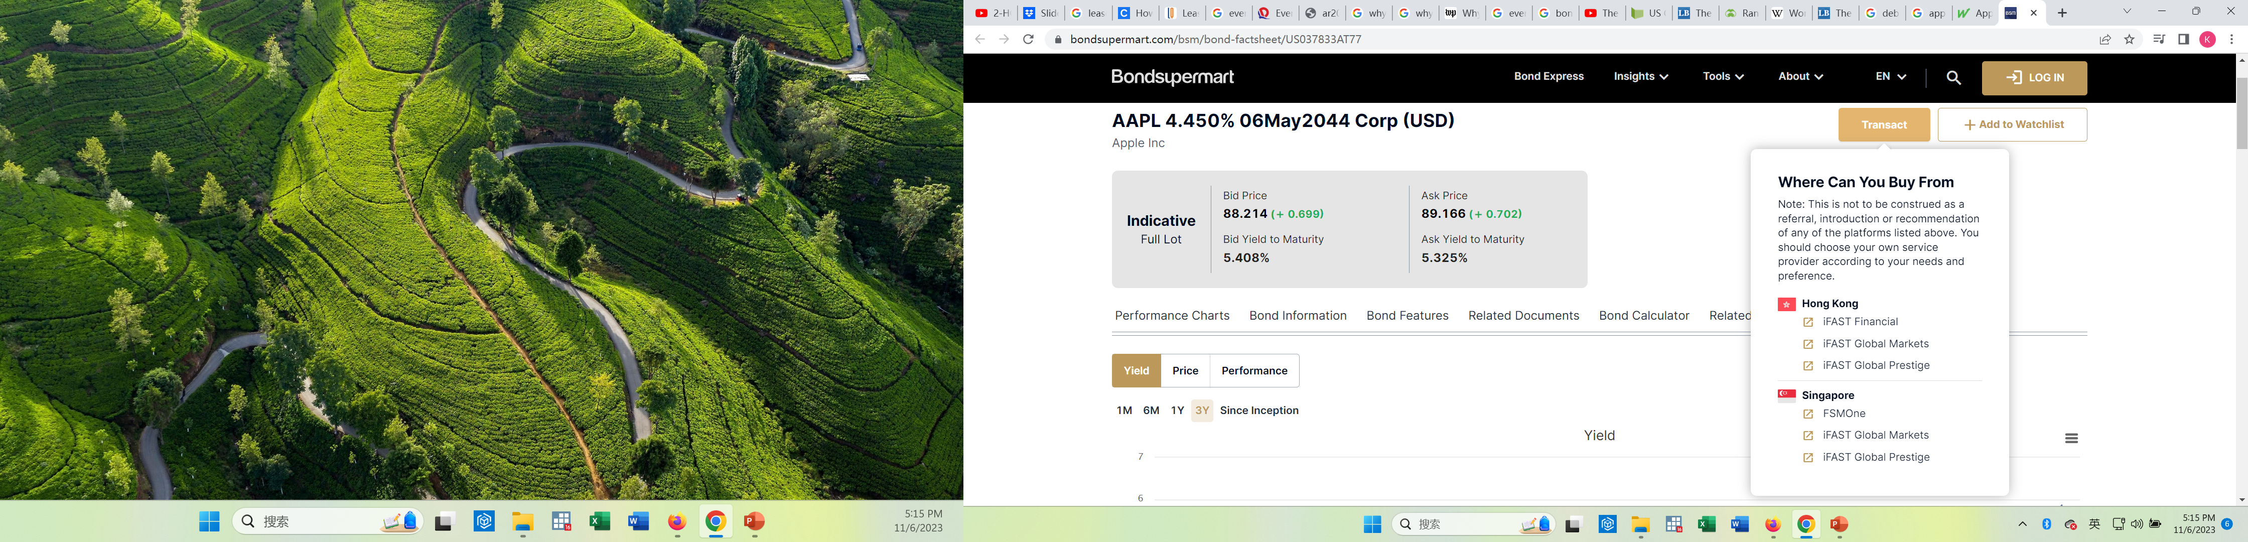
Bond Trading
Bondholders can sell their bonds at any time on national securities exchanges
Bonds prices are quoted as a percentage of face value
Market information for bonds:
L O 1
Notes:
Can also trade bonds.

Slide 17
Determining the Market Price of a Bond
Current market price (present value) of a bond is a function of three factors:
amounts to be received,
length of time until amounts are received, and
market rate of interest (investor demanded rate).
market rate of interest is often not the contractual/stated interest rate
L O 1

Slide 18
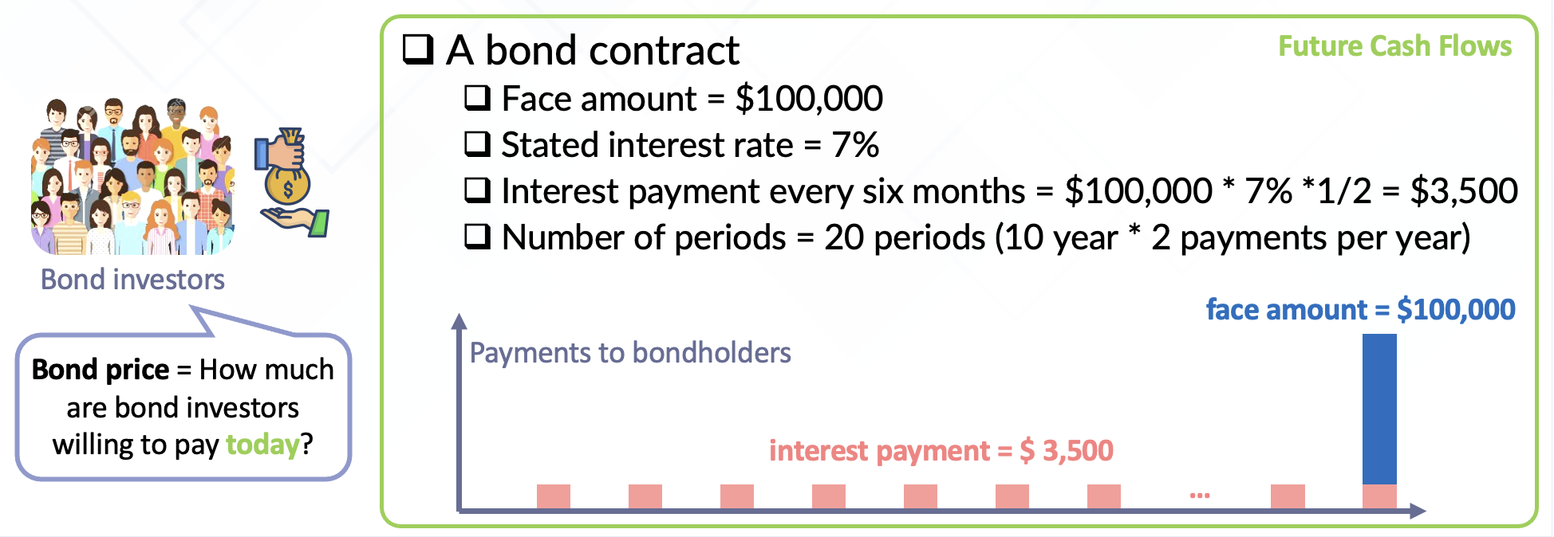
Bond Pricing
On January 1, 2021, California Coasters raises money for development of new roller coaster by issuing $100,000 of bonds, paying a stated interest rate of 7% each year. The bonds are due in 10 years, with interest payable semi-annually on June 30 and December 31.
Notes:
Company raise money by issuing bond… face amount is $100,000 → amount to be paid at maturity
stated interest rate: interest rate on the bond certificate.
Bond due in 10 yrs, semi-annual payment.
Investor will receive two different sets of CF
Face amount = $100,000 at the end of 10 years
Int Pmt: 35,000 each six months ($100,000 * 7% * ½)… this is calculated by the stated interest rate.
Question: If bond can provide this CF, at which price will the bond be sold for today? This is the issue price.
In order to answer this question, we need to think about the time value of money.

Slide 19
DO IT! 1: Bond Terminology – Solution
State whether each of the following statements is true or false.
The stated interest rate is the rate investors demand for loaning funds. False
market rate of interest is the investor demanded rates; sometimes this rate is also called discount rate or effective rates or yield to maturity.
The face value is the amount of principal the issuing company must pay at the maturity date. True
L O 1

Slide 20
Time value of the money
Which of the following do you prefer?
Receive $1,000,000 today
Receive $1,000,000 in 10 years

Slide 21
Time value of the money
Which of the following do you prefer?
Receive $1,000,000 today
Receive $1,005,000 in 10 years

Slide 22
Time value of the money
Which of the following do you prefer?
Receive $1,000,000 today
Receive $100,000,000 in 10 years

Slide 23
Time value of the money
Time value of money is used in calculation of the issue price of bond
Value of money can be different at different points in time.
$1 today is worth more than $1 in one year
Because over time, you can use money to generate returns
Compound interest is used in calculating the time value of money
Interest earned on the initial investment and on previous interest

Slide 24
Revisiting Bond Pricing
Notes:
The stated interest rate: Specified in the bond contract
Used to compute interest payments
The market interest rate: not specified in the bond contract.
Investors’ demand a higher market rate for bonds that have a higher default risk
Used to compute price of bond

Slide 25
Revisiting Bond Pricing
Need to understand that there are two parts in bonds
Face Amount: $100,000 in 10 years
PV of single amount
Interest Pmts: $3,500 semi-annually
PV of annuity (cash payment of equal amount over time periods of equal length)
We need to compute what these two components are worth today.
Notes:
The stated interest rate: Specified in the bond contract
Used to compute interest payments
The market interest rate: not specified in the bond contract.
Investors’ demand a higher market rate for bonds that have a higher default risk
Used to compute price of bond

Slide 26
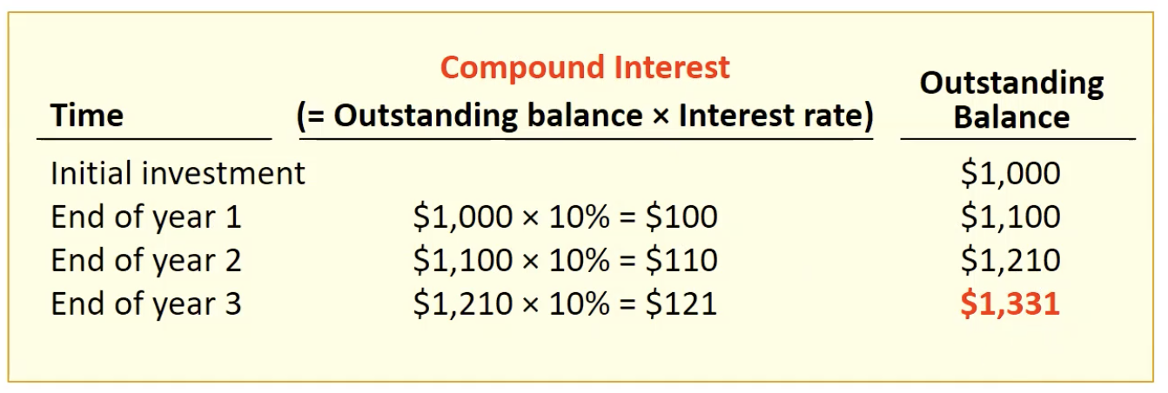
Future Value and Present Value
Suppose you put $1,000 into a savings account that pays compound interest of 10%. You withdraw the money at the end of the three years.
Notes:
1331 is future value of money … i.e., $1000 today is worth $1331 in 3 years.
1000 is present value of money … i.e., $1331 in 3 years is worth $1000 today.

Slide 27
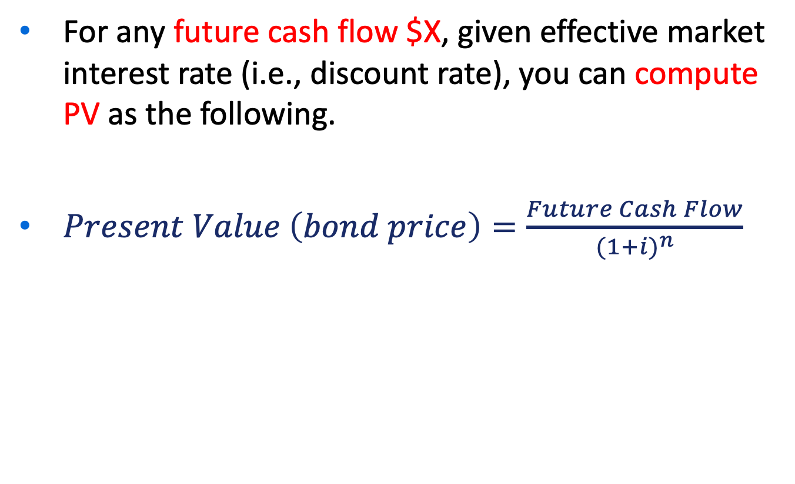
Formula: PV of Single Amount
For any future cash flow $X, given effective market interest rate (i.e., discount rate), you can compute PV as the following.
$Present Value \left(bond price\right)=\frac{Future Cash Flow}{{(1+i)}^{n}}$

Slide 28
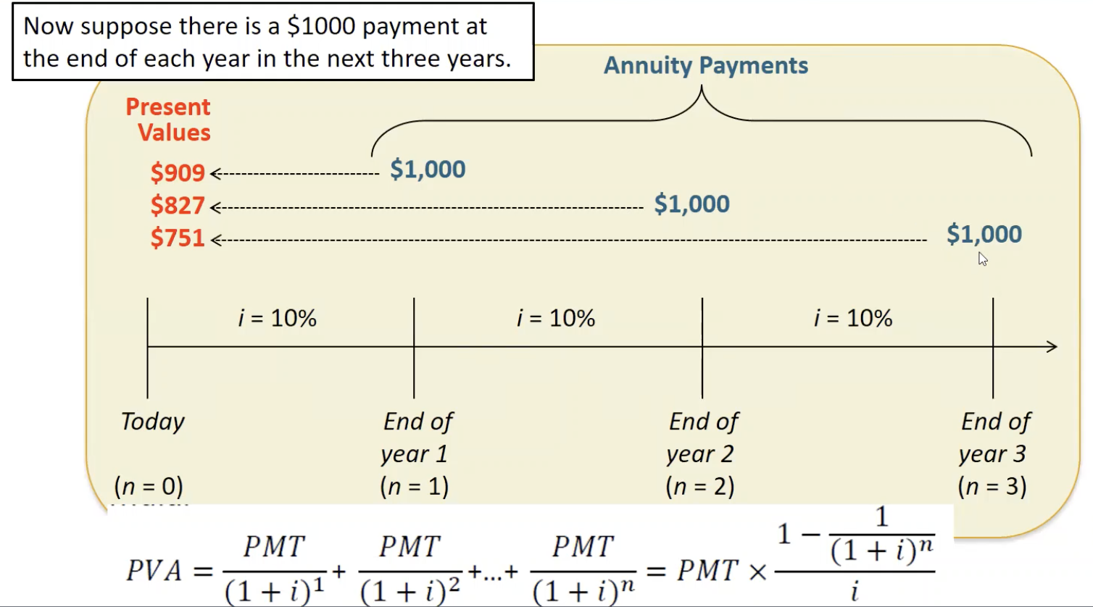
PV of Annuity
Notes:
At end of each period, we receive equal amount. This is called an annuity.

Slide 29
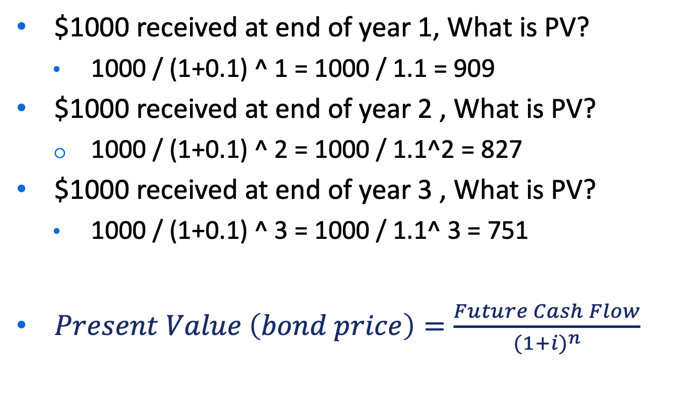
Formula: PV of Annuity
$1000 received at end of year 1, What is PV?
1000 / (1+0.1) ^ 1 = 1000 / 1.1 = 909
$1000 received at end of year 2 , What is PV?
1000 / (1+0.1) ^ 2 = 1000 / 1.1^2 = 827
$1000 received at end of year 3 , What is PV?
1000 / (1+0.1) ^ 3 = 1000 / 1.1^ 3 = 751
$Present Value \left(bond price\right)=\frac{Future Cash Flow}{{(1+i)}^{n}}$

Slide 30
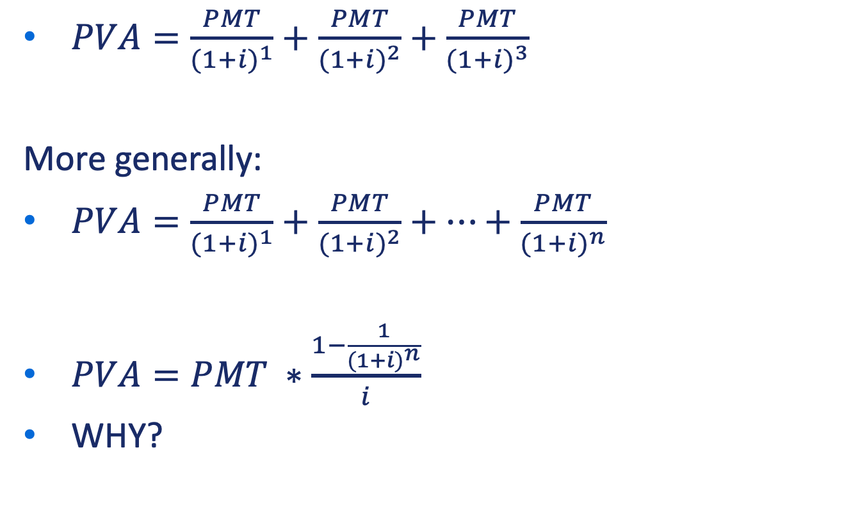
PV of Annuity (Cont’d)
$PVA=\frac{PMT}{{(1+i)}^{1}}+\frac{PMT}{{(1+i)}^{2}}+\frac{PMT}{{(1+i)}^{3}}$
More generally:
$PVA=\frac{PMT}{{(1+i)}^{1}}+\frac{PMT}{{(1+i)}^{2}}+…+\frac{PMT}{{(1+i)}^{n}}$
$PVA=PMT ∗\frac{1−\frac{1}{{(1+i)}^{n}}}{i}$
WHY?

Slide 31
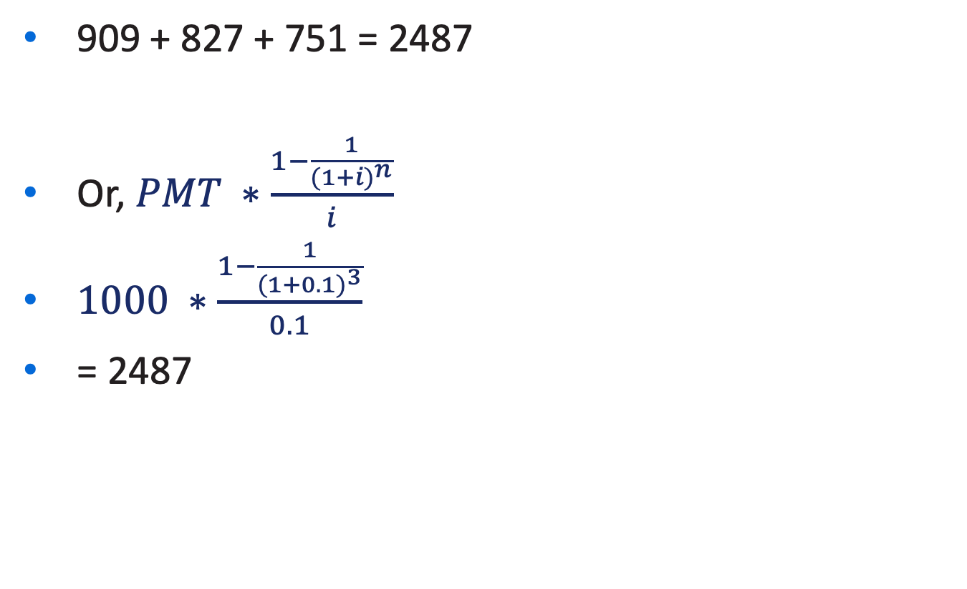
PV of Annuity (Cont’d)
909 + 827 + 751 = 2487
Or, $PMT ∗\frac{1−\frac{1}{{(1+i)}^{n}}}{i}$
$1000 ∗\frac{1−\frac{1}{{(1+0.1)}^{3}}}{0.1}$
= 2487

Slide 32
Pricing of Bond
Talked about two interest rates
The stated interest rate: Specified in the bond contract
Used to compute interest payments
The market interest rate: not specified in the bond contract.
Investors’ demand a higher market rate for bonds that have a higher default risk
Used to compute price of bond

Slide 33
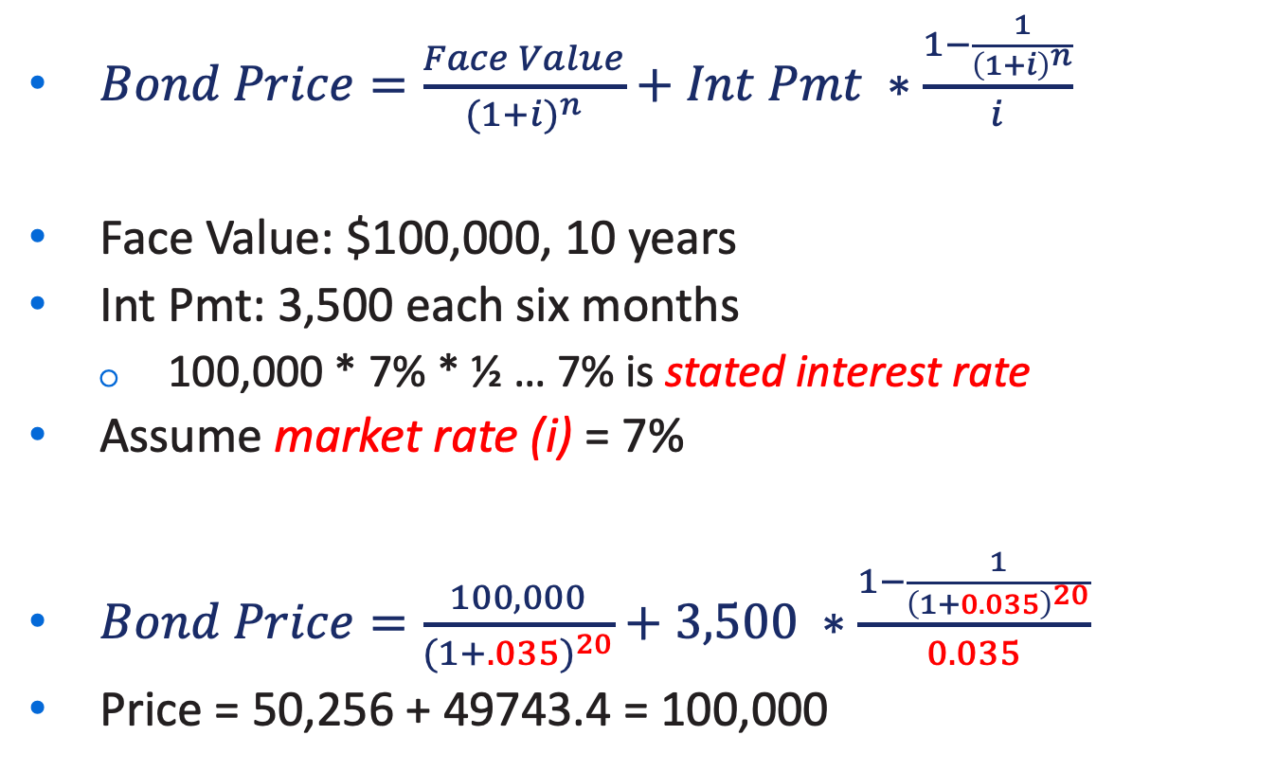
Pricing of Bond
$Bond Price=\frac{Face Value}{{(1+i)}^{n}}+Int Pmt ∗\frac{1−\frac{1}{{\left(1+i\right)}^{n}}}{i}$
Face Value: $100,000, 10 years
Int Pmt: 3,500 each six months
100,000 * 7% * ½ … 7% is stated interest rate
Assume market rate (i) = 7%
$Bond Price=\frac{100,000}{{(1+.035)}^{20}}+3,500 ∗\frac{1−\frac{1}{{\left(1+0.035\right)}^{20}}}{0.035}$
Price = 50,256 + 49743.4 = 100,000
Notes:
Bond price is determined by investors’ demand … so we need to use market rate
What happened? Current price is equal to face value?

Slide 34
Issuing Bonds
Market rate can be equal to, less than, or greater than the stated interest rate paid to investors
If market rate = stated rate, bond is issued at face amount (issued at par)
If market rate > stated rate, bond is issued at below face value (issued at discount)
Bond selling at lower price than face amount
If market rate < stated rate, bond is issued at above face amount (issued at premium)
Bond selling at higher price than face amount
L O 2

Slide 35
Economic Meaning
Issued at par (stated rate = market rate)
Stated rate meets bond investors’ expectation
Issued at discount (stated rate < market rate)
Stated rate is less attractive to bond investors, so need to sell it at discount
Issued at premium (stated rate > market rate)
Stated rate is more attractive to bond investors, so need to sell it at premium

Slide 36
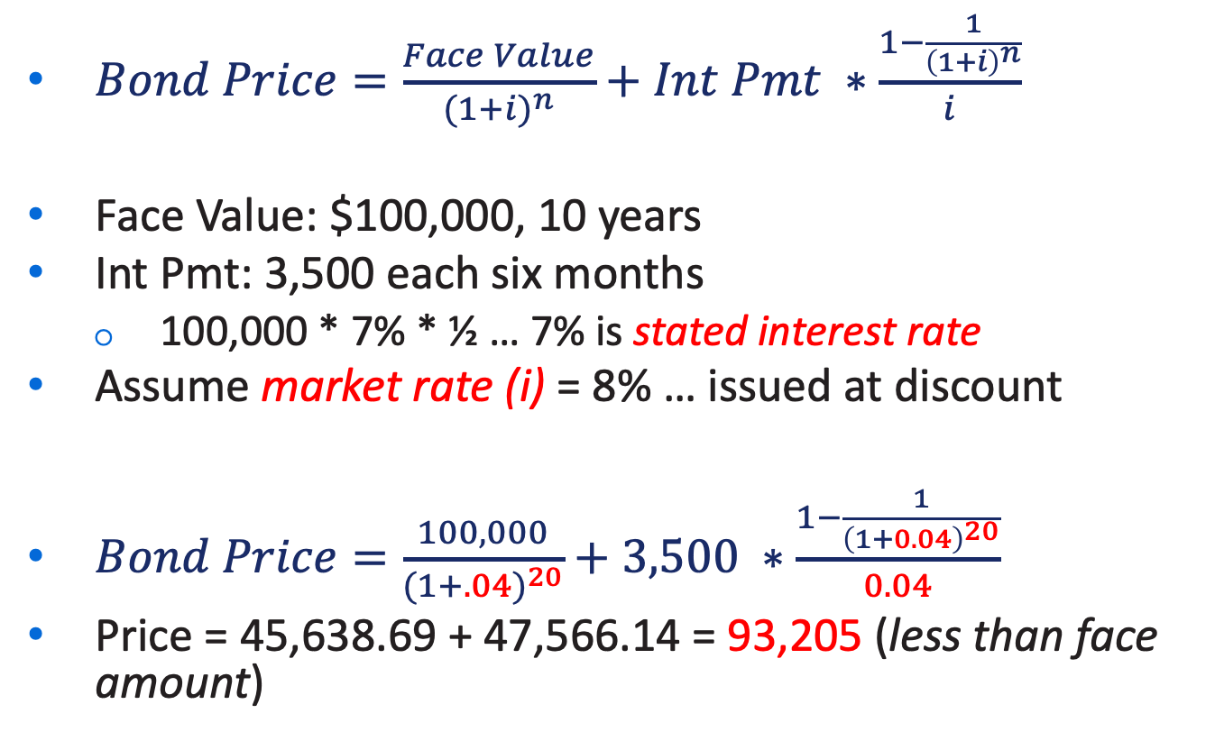
Let’s Verify (Issued at Discount)
$Bond Price=\frac{Face Value}{{(1+i)}^{n}}+Int Pmt ∗\frac{1−\frac{1}{{\left(1+i\right)}^{n}}}{i}$
Face Value: $100,000, 10 years
Int Pmt: 3,500 each six months
100,000 * 7% * ½ … 7% is stated interest rate
Assume market rate (i) = 8% … issued at discount
$Bond Price=\frac{100,000}{{(1+.04)}^{20}}+3,500 ∗\frac{1−\frac{1}{{\left(1+0.04\right)}^{20}}}{0.04}$
Price = 45,638.69 + 47,566.14 = 93,205 (less than face amount)
Notes:
Bond price is determined by investors’ demand … so we need to use market rate
Investing in bond is less attractive than investing in market

Slide 37
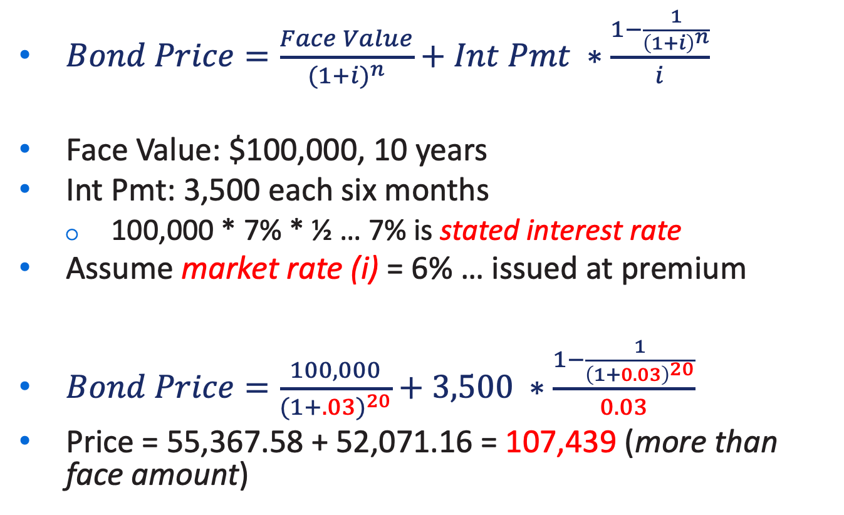
Let’s Verify (Issued at Premium)
$Bond Price=\frac{Face Value}{{(1+i)}^{n}}+Int Pmt ∗\frac{1−\frac{1}{{\left(1+i\right)}^{n}}}{i}$
Face Value: $100,000, 10 years
Int Pmt: 3,500 each six months
100,000 * 7% * ½ … 7% is stated interest rate
Assume market rate (i) = 6% … issued at premium
$Bond Price=\frac{100,000}{{(1+.03)}^{20}}+3,500 ∗\frac{1−\frac{1}{{\left(1+0.03\right)}^{20}}}{0.03}$
Price = 55,367.58 + 52,071.16 = 107,439 (more than face amount)
Notes:
Investing in bond is more attractive than investing in market

Slide 38
Intuition
Market Rate ?
Stated Rate : 7%
Face Amount : 10000
Number of Periods : 3 yrs
Payment period (lets assume annual)

Slide 39
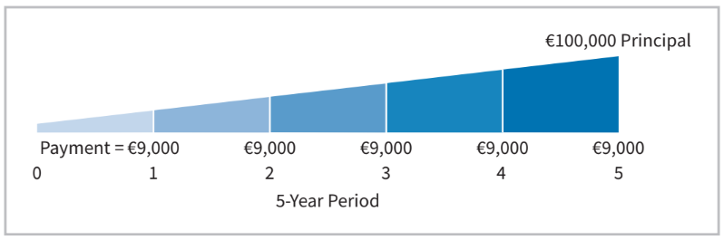
Example: Bond Price
Illustration: Assume that Acropolis SA on January 1, 2025, issues €100,000 of 9% bonds, due in five years, with interest payable annually at year-end. Assume market rate is 9%. What is price of bond?
Present value of €100,000 received in 5 years | € 64,993
Present value of €9,000 received annually for 5 years | 35,007
Market price of bonds | €100,000

Slide 40
Learning Objective 2 Explain How to Account for Bond Transactions.
L O 2
Notes:
Recap computing bond price.

Slide 41
Revisiting Bond Pricing
Notes:
The stated interest rate: Specified in the bond contract
Used to compute interest payments
The market interest rate: not specified in the bond contract.
Investors’ demand a higher market rate for bonds that have a higher default risk
Used to compute price of bond

Slide 42
Pricing of Bond
$Bond Price=\frac{Face Value}{{(1+i)}^{n}}+Int Pmt ∗\frac{1−\frac{1}{{\left(1+i\right)}^{n}}}{i}$
Face Value: $100,000, 10 years
Int Pmt: 3,500 each six months
100,000 * 7% * ½ … 7% is stated interest rate
Assume market rate (i) = 7%
$Bond Price=\frac{100,000}{{(1+.035)}^{20}}+3,500 ∗\frac{1−\frac{1}{{\left(1+0.035\right)}^{20}}}{0.035}$
Price = 50,256 + 49743.4 = 100,000
Notes:
Bond price is determined by investors’ demand … so we need to use market rate
What happened? Current price is equal to face value?

Slide 43
Accounting for Bond Transactions
A company records bond transactions when
it issues (sells) or redeems (buys back) bonds
bondholders convert bonds into ordinary shares (convertible bonds)
Bonds may be issued at
face value (issued at par)
below face value (issued at discount)
above face value (issued at premium)
Bond prices are quoted as a percentage of face value
L O 2

Slide 44
Issuing Bonds at Face Value
Illustration: On January 1, 2025, Candlestick AG issues €100,000, five-year, 10% bonds at 100 (100% of face value). The entry to record the sale is:
Jan. 1
Cash 100,000
Bonds Payable 100,000
Prepare the entry Candlestick would make to accrue interest on December 31.
Dec. 31
Interest Expense 10,000
Interest Payable 10,000
(€100,000 × 10% × 12/12)
L O 2
Notes:
Recording bond transcation for differneet transactions … this is for par value.
On issue date, company owe same amount as selling price (issued at face value).
Issue bond: selling bonds for cash. Issuer is borrower.
Dec 31: Int Exp … they have right to use money over certain period of time … incurred expense.
Int payable: determined by face amount of bond and stated interest rate.

Slide 45
Issuing Bonds at Face Value – Interest Payment
Prepare the entry Candlestick would make to pay the interest on Jan. 1, 2026.
Jan. 1
Interest Payable 10,000
Cash 10,000
L O 2

Slide 46
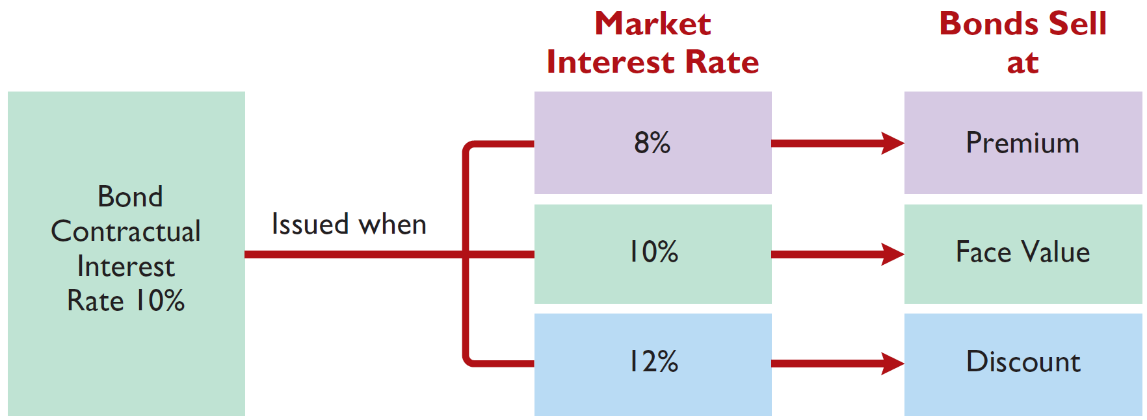
Discount or Premium on Bonds
Interest Rates and Bond Prices
Bond price>principal
Bond price=principal
Bond price<principal
Illustration 11.5: Interest rates and bond prices
L O 2

Slide 47
Accounting for Bond Transactions
Bonds may be issued at
face value (issued at par)
below face value (issued at discount)
above face value (issued at premium)
L O 2

Slide 48
Issuing Bonds at a Discount – Illustration
Illustration: Assume that on January 1, 2025, Candlestick AG sells €100,000, five-year, 10% bonds for €98,000 (98% of face value). Interest is payable annually on January 1. The entry to record the issuance is as follows.
Jan. 1
Cash 98,000
Bonds Payable 98,000
Where €98,000 is the present value of the bond on January 1st, 2025
L O 2
Notes:
Stated rate < Mkt Rate ... Issued at discount
Only borrowed 98,000 from the bondholder. So B/P is 98,000 … this is called carrying value of bond.

Slide 49
Bond Issuance at Discount (1)
Notice we sold $100,000 bond for $98,000
Stated Int Rate < Mkt Rate; my bond is less attractive
There is $2,000 short fall.
But I need to pay $100,000 when bond matures, because that is the face value.
This means, I’m paying $2,000 more than what I received.
The $2,000 is not treated as a lump sum at the end, but is treated as “additional cost of borrowing”
L O 2

Slide 50
Bond Issuance at Discount (2)
Notice we sold $100,000 bond for $98,000
In addition to $100,000 that I pay at maturity, I need to pay interest.
$10,000 for 5 years, totaling $50,000
From previous slide, we have $2,000 (discount)
Total cost of borrowing: $52,000
L O 2

Slide 51
Total Cost of Borrowing Illustrated
Total Cash Outflow minus Total Cash Inflow
= (100,000 + 50,000) – 98,000 = 52,000: Composed of 50,000 + 2,000
Bonds Issued at a Discount
Principal interest | €100,000
Annual interest payments (€10,000 × 5) | 50,000
Cash to be paid to bondholders | 150,000
Less: Cash received from bondholders | 98,000
Total cost of borrowing | €52,000
L O 2
Notes:
Cost of borrowing: Computed as difference between total cash that I pay to bondholder and total cash that I received from bondholder.

Slide 52
Accounting for bond discount
Bond discount is additional cost of borrowing due to selling at discount.
We do not treat as additional expense at maturity. We recognize over the life of bond (called amortization of bond discount).
We allocate to interest expense in each period
How?
L O 2

Slide 53
Effective-Interest Method (1 of 2)
Want to spread out discount over life of bond
Align interest expense incurred in each period with expected interest based on the market rate at time of issuance
L O 5
Notes:
(Idea is similar to declining balance method for depreciation)

Slide 54
Effective-Interest Method Computation
Amortization of the discount or premium results in interest expense equal to a constant percentage of the carrying value.
Illustration 11A.1: Computation of amortization─effective-interest method
L O 5
Notes:
Required steps: Compute bond interest expense; Compute bond interest paid or accrued; Compute amortization amount.
Carrying value of bonds at beginning:
Carrying value is initially reported at issuance price (98,000)… liability as Bond Payable. Over time, it is adjusted for amortization, in this case, portion of discount is recognized as expense. Thus, carrying value increases. Think of bond discount as a deferred cost … we are spreading out the discount over the life of the bond. When we recognize the deferred cost each year, the carrying value (i.e., liability) increases until it matches the amount that will be paid in maturity.
Int Exp: Total amount owed (carrying value) * market rate (i.e., effective interest rate)
2)
How much is actual interest paid: this is specificed on the bond contract
Difference is amortization amount.

Slide 55
Amortizing Bond Discount - Journal
Illustration: Assume that on January 1, 2025, Candlestick AG sells €100,000, five-year, 10% bonds for €98,000 (98% of face value). The effective market interest rate is 10.5348%
Cash 98,000
Bonds Payable 98,000
L O 5

Slide 56
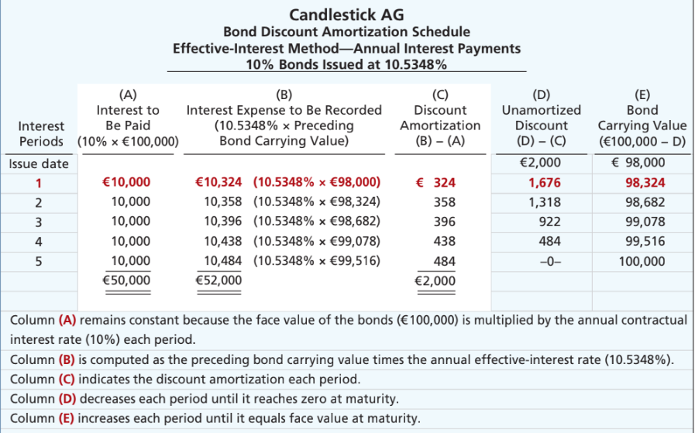
Bond Discount Amortization Schedule
Illustration 11A.2: Bond discount amortization schedule
L O 5
Notes:
Bond carrying value: On issue date, company sell at issue price of 98,000. This is how much we owe to bondholders (carrying value).
Total unamortized discount = 2000 (difference between face value and carrying value)
Interest payment (Col A): 5 payments of 10,000 in interest to bondholder.
Interest Exp (Col B): Apply market rate to the carrying amount of the bond at beginning of year. Reflects the cost of borrowing based on market conditions when bond was issued. In short, how much does company owe to bondholders.
Amortization of Discount (Col C): Since mkt rate is higher than coupon rate, int expense is more than the payment. The difference is the discount being amortized for the year. We are not paying enough. We owe more money to bondholders. We owe more, so carrying value is increased.
Carrying value (Col E): Increases by the amortized discount each year. By end of term, carrying amount equals face value.
Difference between interest to be paid (10,000 per year) and interest expense, we get discount.

Slide 57
Amortizing Bond Discount - Journal
Illustration: Candlestick AG records the accrual of interest and amortization of bond discount on Dec. 31, as follows:
Year 1 Dec. 31
Interest Expense 10,324
Bonds Payable 324
Interest Payable 10,000
Step 1. Interest Expense = carrying value at the beg period (98,000) * effective market interest rate (10.5348%)=10324
Step 2. Interest paid: face value * contractual rate =10,000
Step 3. Amortization: 324
L O 5
Notes:
At end of first period, we record accrual of interest, which is int exp.
Int Exp = 10324.
Int Pay = 10,000 … periodic int pmt (haven’t paid yet, because pay tomorrow)
B/P = 324 … Discount amortization over the period. The amount to be paid is less than what bondholers demand (i.e., interest expense incurred), which increases our liability (i.e., owe more money).

Slide 58
Bond Discount Amortization Schedule
Illustration 11A.2: Bond discount amortization schedule
L O 5

Slide 59
Amortizing Bond Discount - Journal
Illustration: Candlestick AG records the accrual of interest and amortization of bond discount on Dec. 31, as follows:
Year 2 Dec. 31
Interest Expense 10,358
Bonds Payable 358
Interest Payable 10,000
Step 1. Interest Expense = carrying value at the beg period (98,324) * effective market interest rate (10.5348%)=10358
Step 2. Interest paid: face value * contractual rate =10,000
Step 3. Amortization: 358
L O 5
Notes:
Cash to be paid is 10,000. We are paying less, so we owe more money. Overtime, carrying value increases until it equals face value.

Slide 60
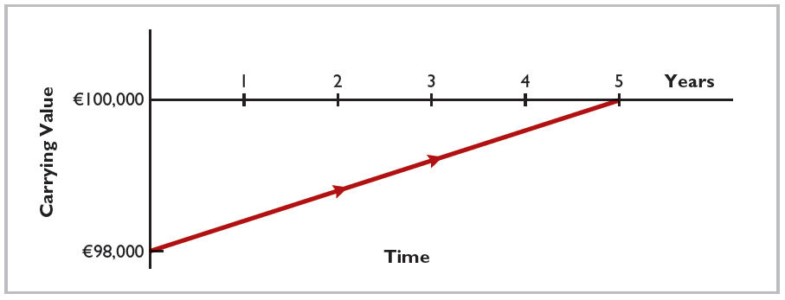
Amortization of Bond Discount
Illustration 11.9: Amortization of bond discount
L O 2

Slide 61
Accounting for Bond Transactions
Bonds may be issued at
face value (issued at par)
below face value (issued at discount)
above face value (issued at premium)
L O 2

Slide 62
Issuing Bonds at a Premium
Illustration: Assume that the Candlestick AG bonds previously described sell for €102,000 (102% of face value). The entry to record the sale is as follows:
Jan. 1
Cash 102,000
Bonds Payable 102,000
L O 2

Slide 63
Bond Issuance at Premium (1)
Notice we sold $100,000 bond for $102,000
Stated Int Rate > Mkt Rate; my bond is more attractive
There is $2,000 premium.
I need to pay $100,000 when bond matures, because that is the face value.
I want to spread the 2,000 premium out over life of bond (amortization of premium). Portion of premium is used to decrease the interest expense.
L O 2

Slide 64
Bond Issuance at Premium (2)
Notice we sold $100,000 bond for $102,000
In addition to $100,000 that I pay at maturity, I need to pay interest.
$10,000 for 5 years, totaling $50,000
From previous slide, we have $2,000 (premium)
Total cost of borrowing: $48,000
L O 2

Slide 65
Total Cost of Borrowing Illustrated (2 of 2)
Total Cash Outflow minus Total Cash Inflow
= (100,000 + 50,000) – 102,000 = 48,000: Composed of 50,000 – 2,000
Bonds Issued at a Premium
Principal interest | €100,000
Annual interest payments (€10,000 × 5) | 50,000
Cash to be paid to bondholders | 150,000
Less: Cash received from bondholders | 102,000
Total cost of borrowing | €48,000
Illustration 11.12: Alternative computation of total cost of borrowing─ bonds issued at a premium
L O 2

Slide 66
Amortizing Bond Premium
Illustration: Candlestick AG sells the bonds described above for €102,000 rather than €98,000. This would result in a bond premium of €2,000 (€102,000 − €100,000). This premium results in an effective-interest rate of approximately 9.4794%.
L O 5

Slide 67
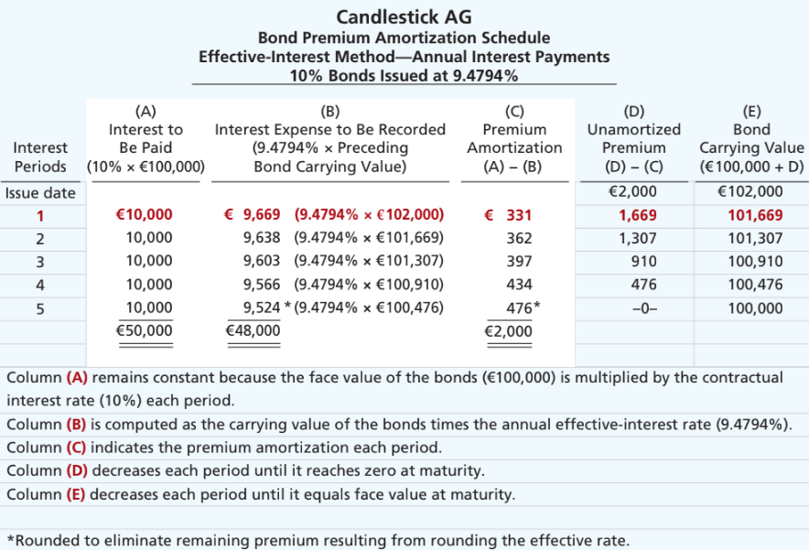
Bond Premium Amortization Schedule
L O 5
Notes:
Issue date: Company owes 102,000 (carrying value).
Int exp = 102,000 * mkt rate = 9669. We are paying more than what we owe. 10,000 covers 2 parts. 331 is used to reduce the principal, the carrying value of the bond.
We do similar exercise as in the discount case.
For last period, we fully allocated premium. The carrying value decreases from issue price to face amount on maturity.

Slide 68
Amortizing Bond Premium - Journal
Illustration: Candlestick AG records the accrual of interest and amortization of premium discount on Dec. 31, as follows:
Dec. 31
Interest Expense 9,669
Bonds Payable 331
Interest Payable 10,000
Bond interest paid (€100,000 × 10%) | €10,000
Less: Bond interest expense (€102,000 × 9.4794%) | 9,669
Bond premium amortization | € 331
Illustration 11A.5: Computation of bond premium amortization
L O 5
Notes:
How much cash is to be paid : 10,000 the payable. We are paying more than expense … remaining value is used to reduce the carrying value (i.e., liability)

Slide 69
Bond Premium Amortization
Allocated to expense in each period
Decreases amount of interest expense reported each period
Amount of interest expense reported each period will be less than contractual amount paid
As premium is amortized, its balance declines
Carrying value of bonds will decrease, until at maturity carrying value of bonds equals their face amount
L O 2

Slide 70
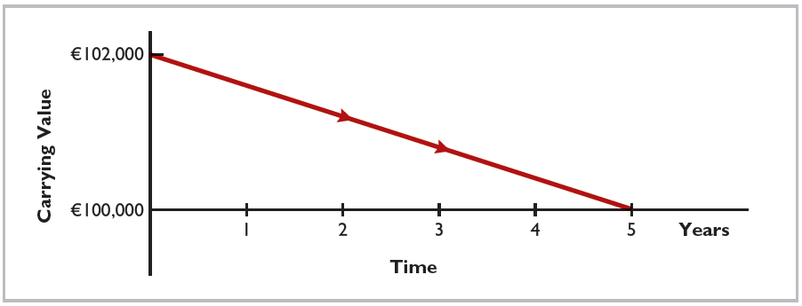
Amortization of Bond Premium
Illustration 11.13: Amortization of bond premium
L O 2

Slide 71
Discount or Premium on Bonds – Review Question
Karson Ltd. issues 10-year bonds with a maturity value of £200,000. If the bonds are issued at a premium, this indicates that:
the contractual interest rate exceeds the market interest rate.
the market interest rate exceeds the contractual interest rate.
the contractual interest rate and the market interest rate are the same.
no relationship exists between the two rates.
L O 2

Slide 72
Discount or Premium on Bonds – Solution
Karson Ltd. issues 10-year bonds with a maturity value of £200,000. If the bonds are issued at a premium, this indicates that:
the contractual interest rate exceeds the market interest rate. (Correct)
the market interest rate exceeds the contractual interest rate.
the contractual interest rate and the market interest rate are the same.
no relationship exists between the two rates.
L O 2

Slide 73
DO IT! 2a: Bond Issuance
Giant Ltd. issues ¥200,000,000 of bonds for ¥189,000,000. (a) Prepare the journal entry to record the issuance of the bonds, and (b) show how the bonds would be reported on the statement of financial position at the date of issuance.
L O 2

Slide 74
DO IT! 2a: Bond Issuance – Solution
a.
Cash 189,000,000
Bonds Payable 189,000,000
b.
Non-current liabilities
Bonds payable ¥189,000,000
L O 2

Slide 75
Redeeming Bonds at Maturity
Candlestick AG records the redemption of its bonds at maturity as follows:
Jan. 1
Bonds Payable 100,000
Cash 100,000
L O 2
Notes:
Pay back the face amount.

Slide 76
Redeeming Bonds before Maturity (1 of 2)
When a company retires bonds before maturity, it is necessary to:
eliminate carrying value of bonds at redemption date
record cash paid (price is market price of bond at date)
recognize gain or loss on redemption
The carrying value of the bonds is the face value of the bonds less unamortized bond discount or plus unamortized bond premium at the redemption date. It is the net book value of the bond reported in financial statements.
It is a little bit like sale of PPE.
L O 2
Notes:
Buying back earlier. (callable bonds)
Buy back from investor … use cash to buy back. Price is market price.
Depending on market price, may have loss or gain.

Slide 77
Redeeming before Maturity Example
Illustration: Assume at the end of the fourth period, Candlestick AG having sold its bonds at a premium, retires the bonds at 103 after paying the annual interest. Assume that the carrying value of the bonds at the redemption date is €100,476. Candlestick records the redemption at the end of the fourth interest period (January 1, 2029) as follows:
Jan. 1
Bonds Payable 100,476
Loss on Bond Redemption 2,524
Cash 103,000
L O 2
Notes:
Spend money to buy back bonds. Need to eliminate bond payable at recorded amount. Mkt price is provided for us (103,000).
For PPE, we are selling asset to get cahs.
For bonds, we are paying cash to clear liability.

Slide 78
Bond Premium Amortization Schedule
L O 5
Notes:
Issue date: Company owes 102,000 (carrying value).
Int exp = 102,000 * mkt rate = 9669. We are paying more than what we owe. 10,000 covers 2 parts. 331 is used to reduce the principal, the carrying value of the bond.
We do similar exercise as in the discount case.
For last period, we fully allocated premium. The carrying value decreases from issue price to face amount on maturity.

Slide 79
DO IT! 2b: Bond Redemption
R & B Ltd. issued £500,000, 10-year bonds at a discount. Prior to maturity, when the carrying value of the bonds is £496,000, the company redeems the bonds at 98 (£500,000 × 98% = £490,000) . Prepare the entry to record the redemption of the bonds.
L O 2
Notes:
Use less cash (490,000) to clear liability (496,000), so is a gain.

Slide 80
DO IT! 2b: Bond Redemption – Solution
Bonds Payable 496,000
Gain on Bond Redemption 6,000
Cash 490,000
L O 2
Notes:
Pay only 490,000

Slide 81
Learning Objective 3 Explain How to Account for Other Non-Current Liabilities.
L O 3

Slide 82
Long-Term Notes Payable
May be secured by a mortgage that pledges title to specific assets as security for a loan
Terms require borrower to make equal installment payments over term of loan.
Each payment consists of
interest on unpaid balance of loan
a reduction of loan principal
Companies initially record mortgage notes payable at face value
L O 3
Notes:
Only one set of CF … equal amt of annuity.

Slide 83
Long-Term Notes Payable Illustration
Illustration: Mongkok Technology Ltd. issues a HK$500,000, 8%, 20-year mortgage note on December 31, 2025. The terms provide for annual installment payments of HK$50,926.
Interest Period | (A) Cash Payment | (B) Interest Expense (D) × 8% | (C) Reduction of Principal (A) − (B) | (D) Principal Balance (D) − (C)
Issue date |  |  |  | HK$500,000
1 | HK$50,926 | HK$40,000 | HK$10,926 | 489,074
2 | 50,926 | 39,126 | 11,800 | 477,274
3 | 50,926 | 38,182 | 12,744 | 464,530
4 | 50,926 | 37,162 | 13,764 | 450,766
Illustration 11.14: Mortgage installment payment schedule
L O 3
Notes:
Face amount = 500,000 … this is amount borrowed. 8% is required rate of return for lender (for them to willingly lend meony, lenders must receive this).
50926: computed as PVA. PVA of 50,000 with 8% return for 20 years is 500,000.
I am paying more than the interest expense. The difference is used to reduce the principal. One covers interest expense, the other covers principal.

Slide 84
Long-Term Notes Payable Example - Journal
Illustration: Mongkok records the mortgage loan and first installment payment as follows:
Dec. 31
Cash 500,000
Mortgage Payable 500,000
Dec. 31
Interest Expense 40,000
Mortgage Payable 10,926
Cash 50,926
L O 3
Notes:
Issue date, borrower principal amount, 500,000.
Int exp = 40,000 for first period. Cash paid = installment payment , 50926. Remaining used to reduce principal.

Slide 85
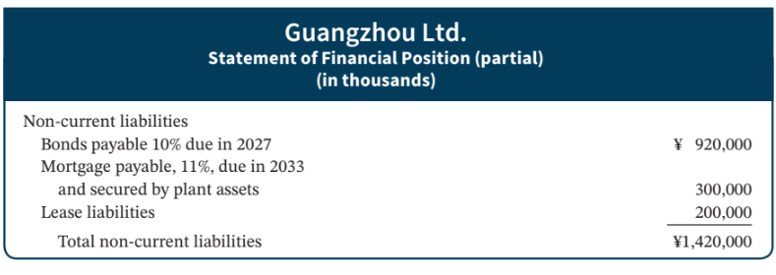
Presentation Illustrated
Illustration 11.15: Statement of financial position presentation of non-current liabilities
L O 4

Slide 86
Learning Objective 4 Discuss How Liabilities are Reported and Analyzed.
L O 4

Slide 87
Analysis (Non-Current liability)
Two ratios that provide information about debt-paying ability and long-run solvency are:
Debt to Assets Ratio
Times Interest Earned Ratio
L O 4

Slide 88
Analysis Example
To illustrate these ratios, we will use data from an LG (KOR) annual report. The company had total liabilities of ₩ 22,839 billion, total assets of ₩ 35,528 billion, interest expense of ₩ 827 billion, income taxes of ₩ 354 billion, and net income of ₩ 223 billion.
Total Liabilities | ÷ | Total Assets | = | Debt to Assets Ratio
₩22,839 | ÷ | ₩35,528 | = | 64.3%
Net Income + Interest Expense + Income Tax Expense | ÷ | Interest Expense | = | Times Interest Earned
₩223 + ₩827 + ₩354 | ÷ | ₩827 | = | 1.70 times
Illustration 11.16: Debt to assets and times interest earned rations, with computations (in billions)
L O 4
Notes:
Debt to assets: TL / TA … how much of company’s resources are supported by debt. Higher it is, higher risk that company is unable to pay back debt.
Times interest earned: Company’s ability to pay their interest using available earnings.
NI + Int Exp + Income Tax Exp = EBIT (Earnings before interest and tax) … company’s earnings before they pay interest and taxes.

Slide 89
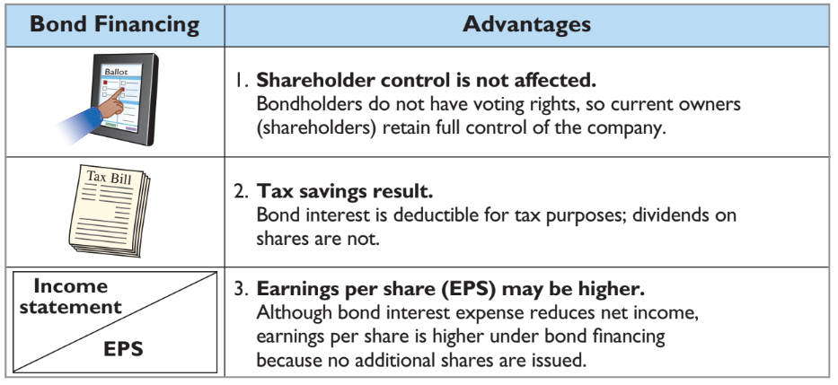
Bond Financing Advantages
Illustration 11.17: Advantages of bond financing over ordinary shares
L O 4

Slide 90
Debt and Equity Financing Example
Illustration: Microsystems is considering two plans for financing the construction of a new €5 million plant. Plan A involves issuance of 200,000 ordinary shares at the current market price of €25 per share. Plan B involves issuance of €5 million, 8% bonds at face value. Income before interest and taxes on the new plant will be €1.5 million. Income taxes are expected to be 30%. Microsystems currently has 100,000 ordinary shares outstanding.
The alternative effects on the return on common shareholders’ equity are shown in the next Illustration.
L O 4

Slide 91
Financing Effects on Earnings
 | Plan A Issue Shares | Plan B Issue Bonds
Income before interest and taxes | €1,500,000 | €1,500,000
Interest (8% × €5,000,000) | — | 400,000
Income before income taxes | 1,500,000 | 1,100,000
Income tax expense (30%) | 450,000 | 330,000
Net income | € 1,050,000 | € 770,000
Outstanding shares | 300,000 | 100,000
Earnings per share | €3.50 | €7.70
Higher interest expense
Tax lower
No share dilution
Higher EPS
Illustration 11.18: Effects on earnings per share─ equity vs. debt
L O 4

